Slide 1
Status Review
07.12.2017

Slide 2
Last week:
Testing according to the standards not possible
Air velocity gradient over the outlet
Chamber regulation bad with lower air velocity
No speed at all at the lowest point
Decision: Further tests to be set with 30pct/2fans (like in previous tests)
Air velocity slightly higher but with a certain velocity at the bottom measuring point
Solder out one condenser and check for oil before flushing
Focus on programming and modeling with Python and EES

Slide 3
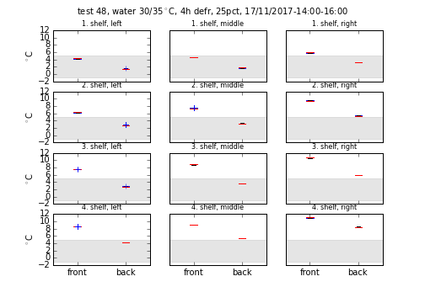
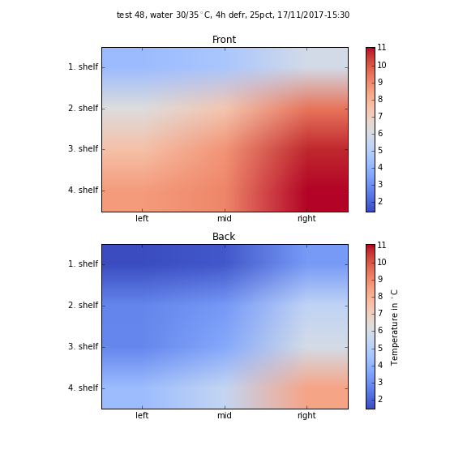
IDC150 analysis with Python
Test Packages Temperatures

Slide 4
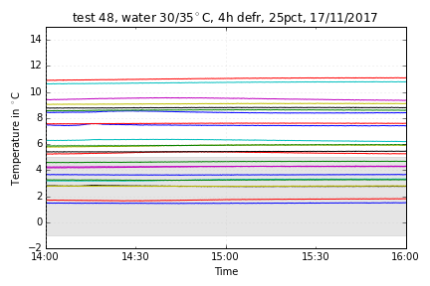
IDC150 analysis with Python
Test Packages Temperatures

Slide 5
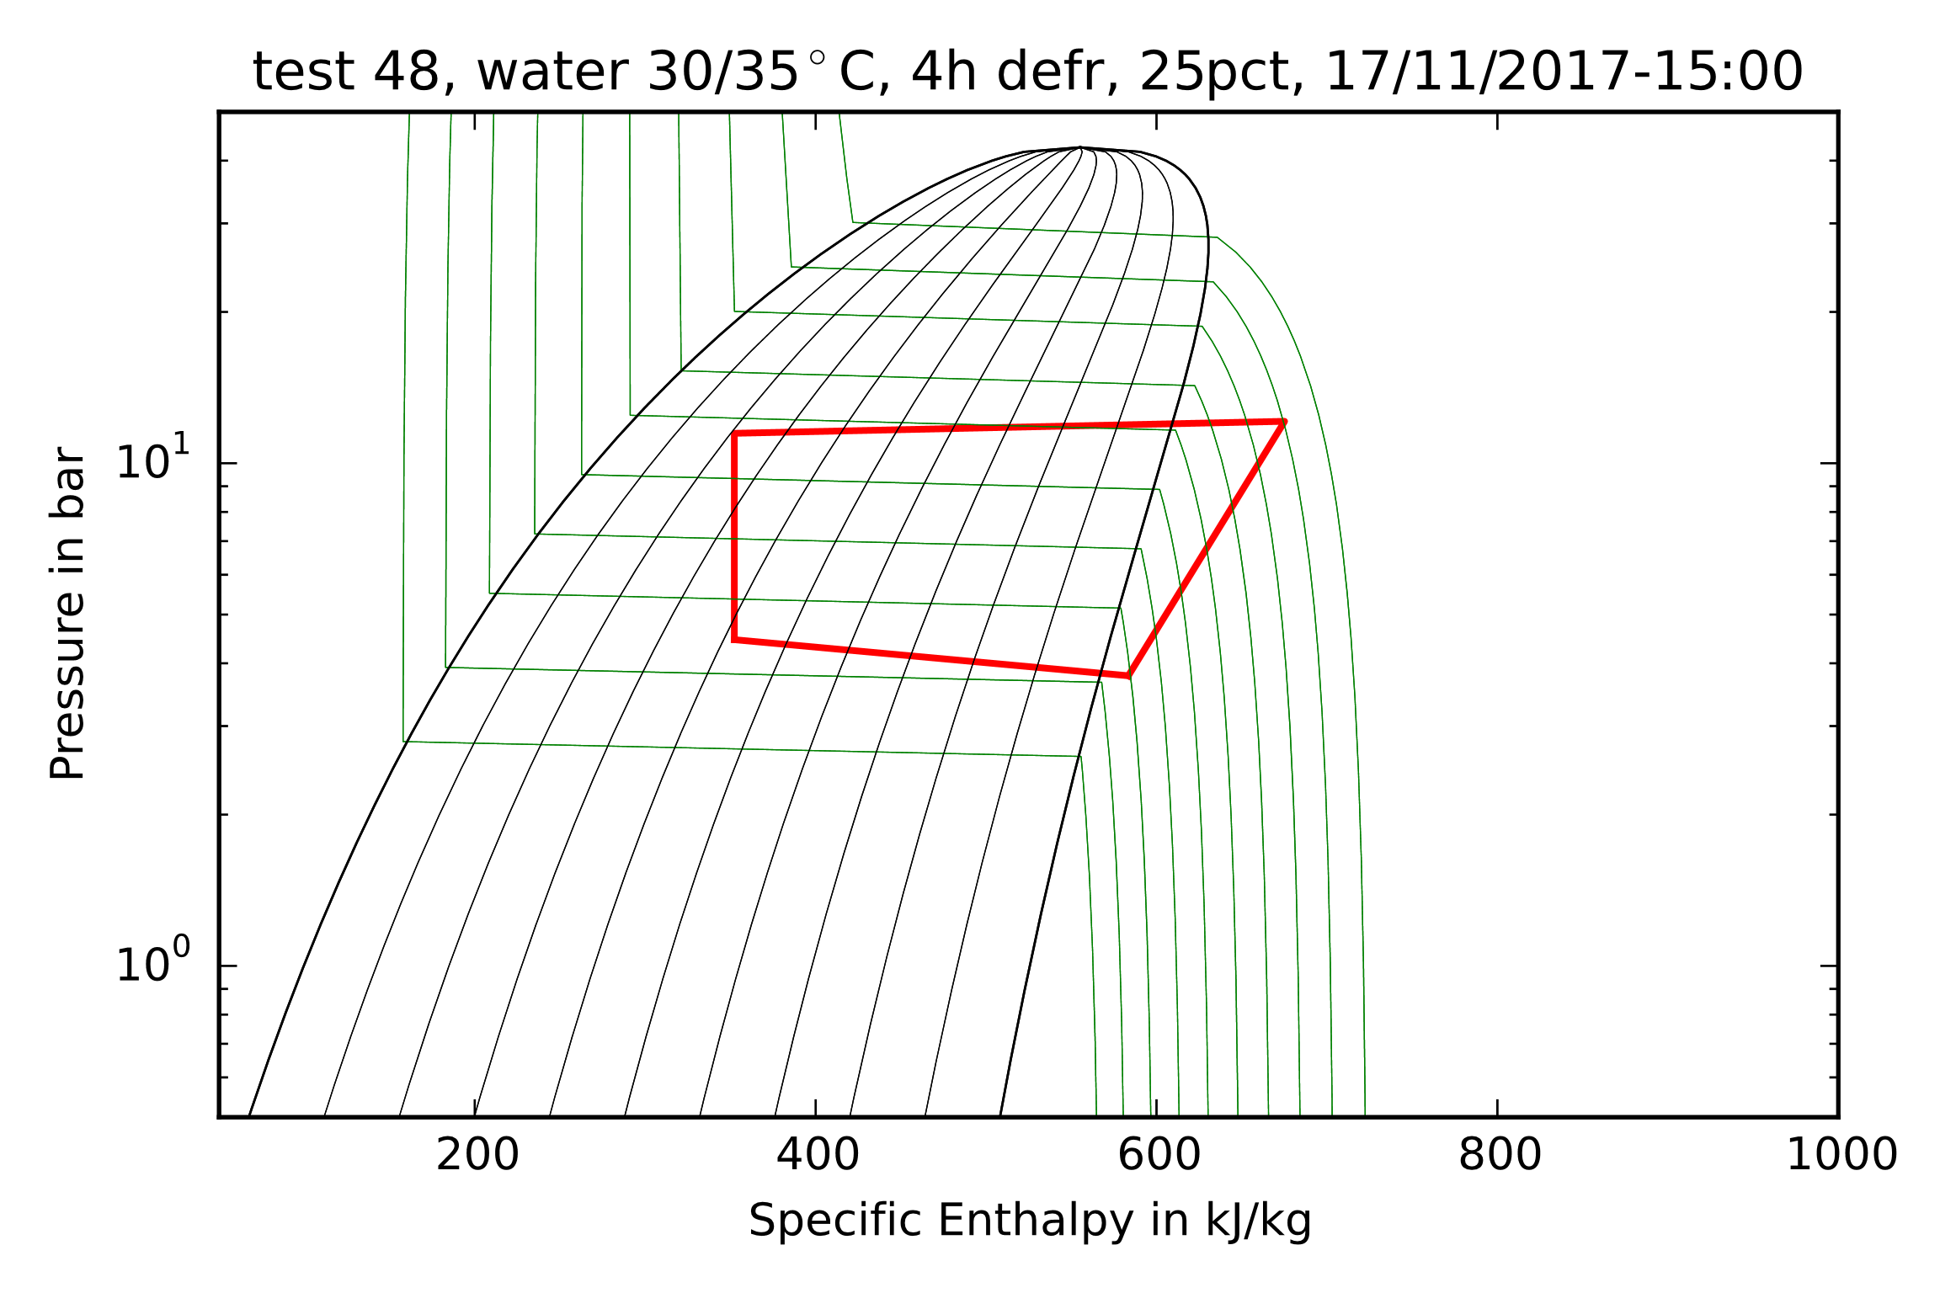
IDC150 analysis with Python
Log pH diagram plot in 2 phase region

Slide 6
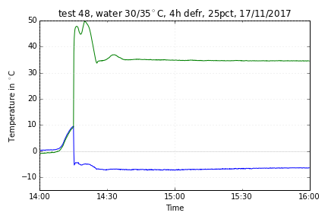
IDC150 analysis with Python
T_cond and T_evap

Slide 7
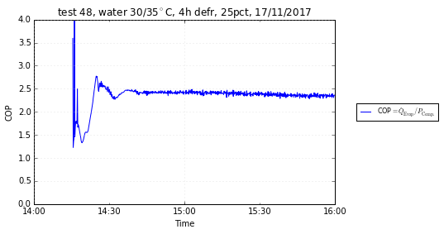
IDC150 analysis with Python
COP

Slide 8
To-Do:

